Slide 1
Measurement and Characterization of a 5T Solenoid Field
Jason Morgan
April 2018

Slide 2
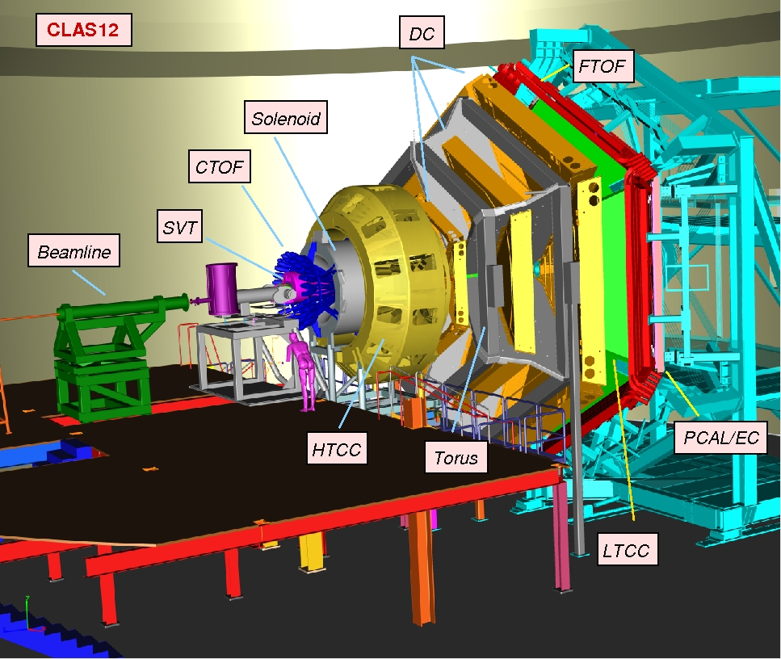
CLAS12
CEBAF Large Acceptance Spectrometer for 12 GeV
3.58T toroidal magnet
5T Solenoid

Slide 3
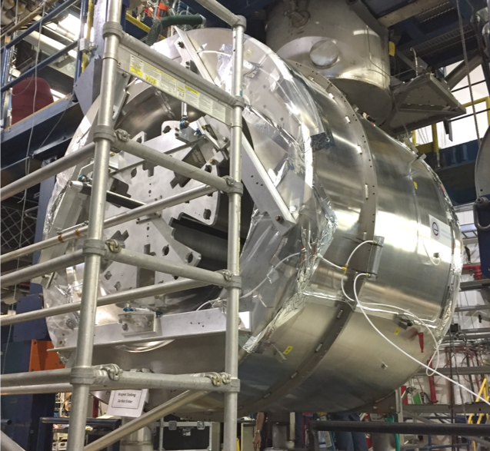
5T SOLENOID
Shields the detectors from the background
Gides high angle particles to the detector
5 coils, 4 main + 1 shield coil
5T central field at 2416A
Installed September 2017
Magnetic field mapped September – October 2017

Slide 4
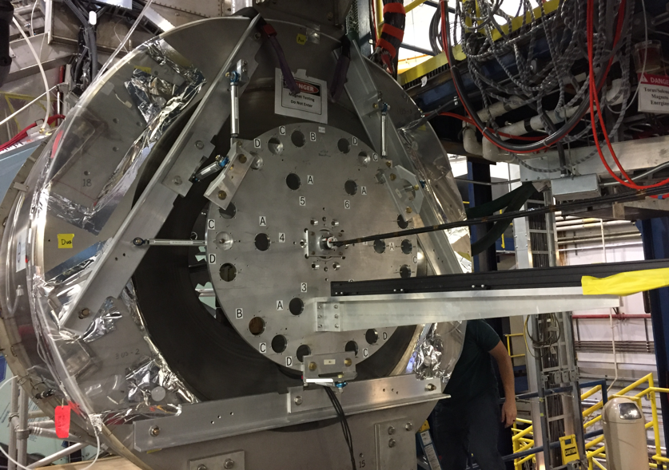
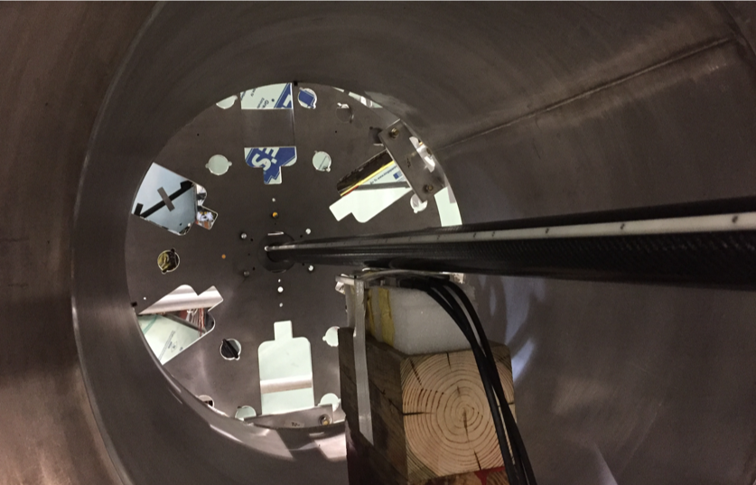
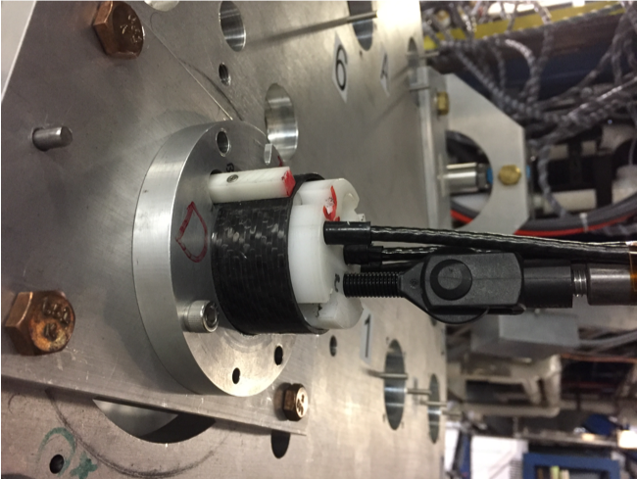
FIELD MAPPING

Slide 5
FIELD MAPPING
Template board with hole to mount probe tube
38 runs of data were looked at at r=0, r=1.25cm and r=30cm
Runs were conducted with various angles of rotation for r = 1.25cm and r=30cm runs
Probes were rotated in the holder at angles of 90, 180 and 270 degrees
Long runs were performed in steps of 2cm spanning a total distance of 200cm
Short fine integral runs were performed in 1mm steps spanning a total distance of 10 cm
Hall probes were inserted in the tubes and pushed down the z axis

Slide 6
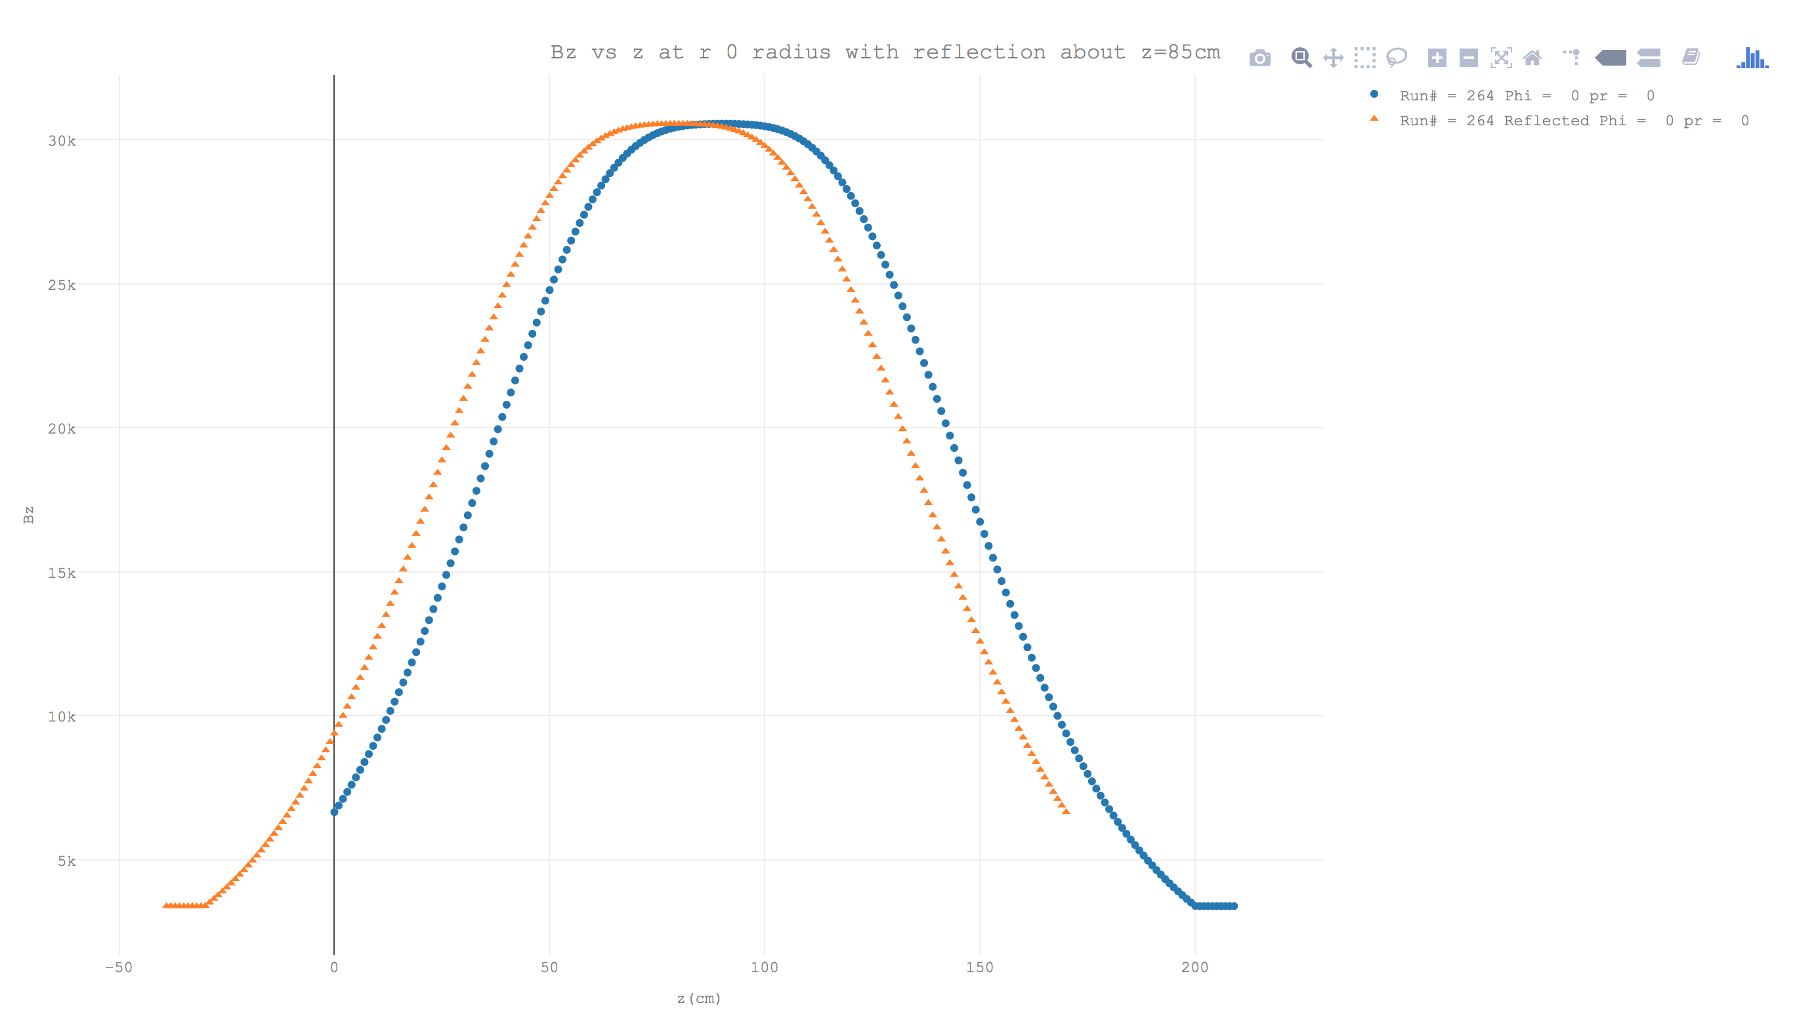
FINDING THE CENTER
Found the center by reflecting the data about various z values
Performed a χ² test and selected the minimum χ²
Calculated χ² for surrounding z values and fit with a quadratic model
Projected this model in 0.01cm steps and selected the minimum to establish the center point for each run
Center z long runs is 89.8 ± 2.3 cm, short runs is 53.4 mm ± 5.0 mm.

Slide 7
TRANSLATIONS
Probe Rotation (pr)° | NormalizedB_{x =} | NormalizedB_{y =}
0 | B_{x} | B_{y}
90 | B_{y} | -B_{x}
180 | -B_{x} | -B_{y}
270 | -B_{y} | B_{x}

Slide 8
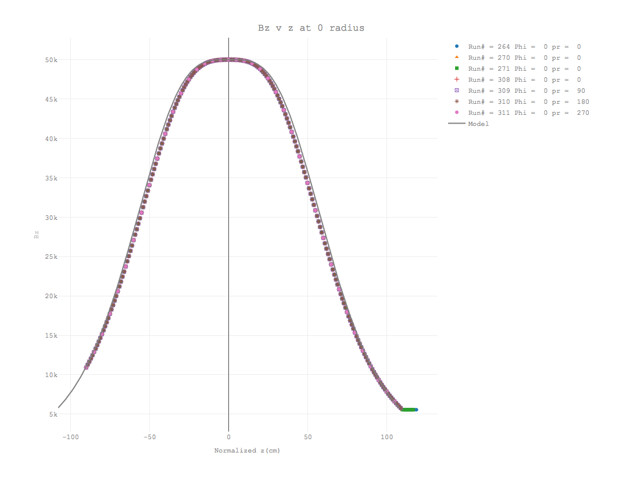
RESULTS

Slide 9
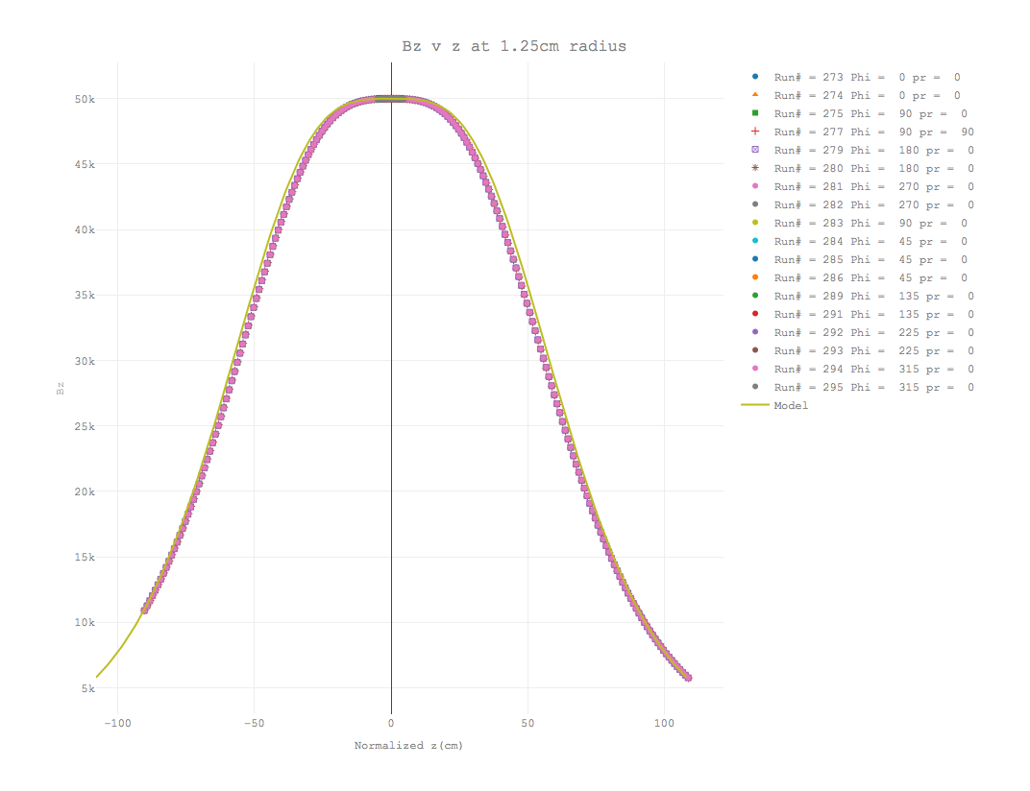
RESULTS

Slide 10
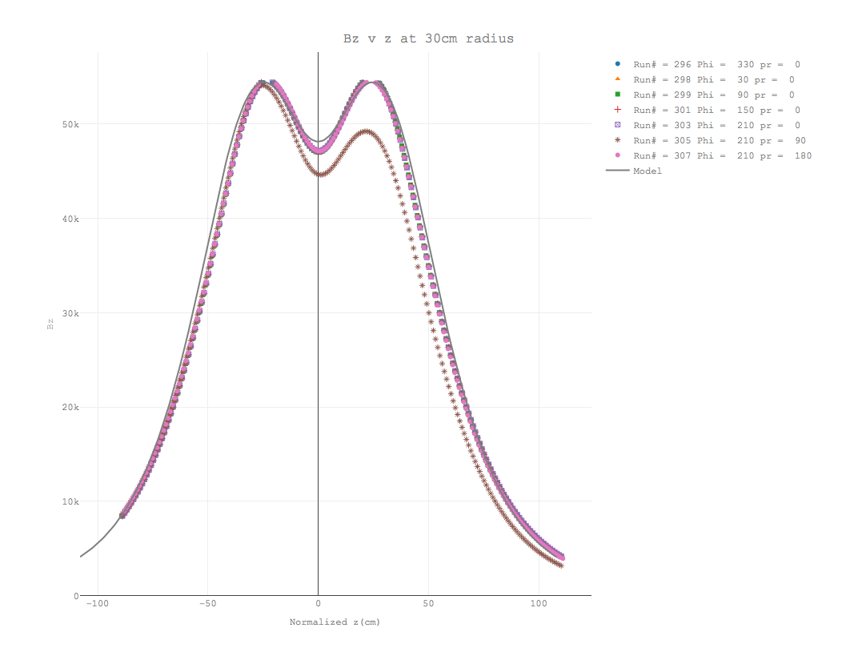
RESULTS

Slide 11
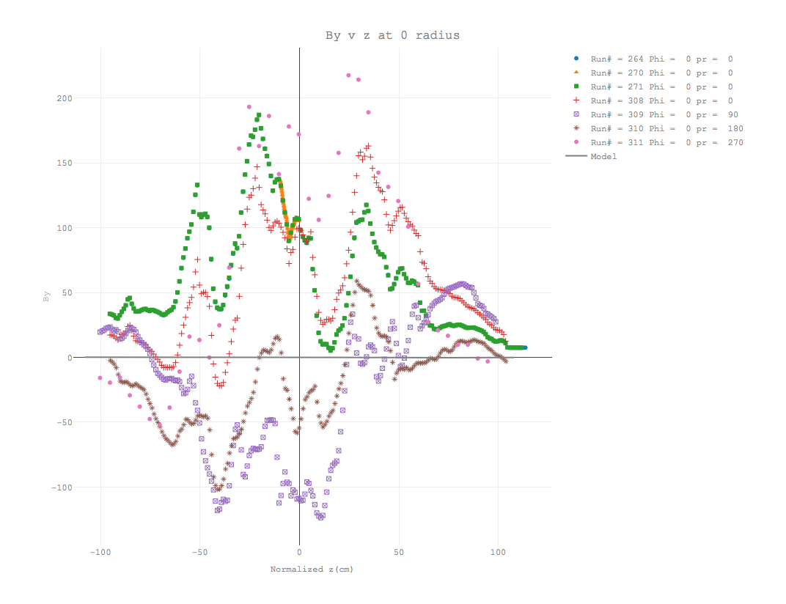
RESULTS

Slide 12
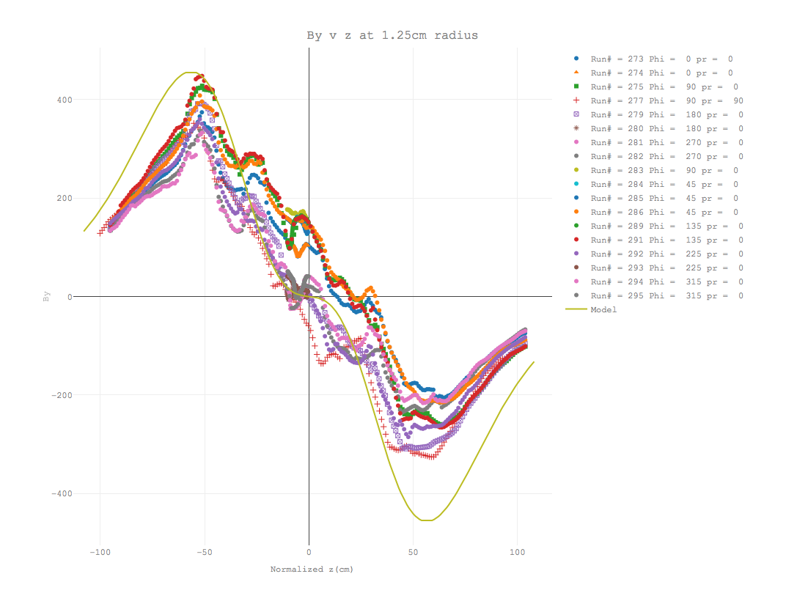
RESULTS

Slide 13
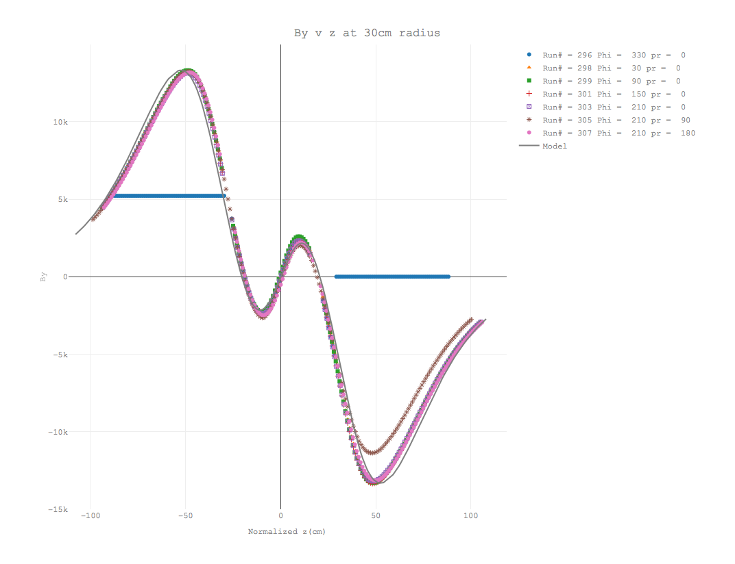
RESULTS

Slide 14
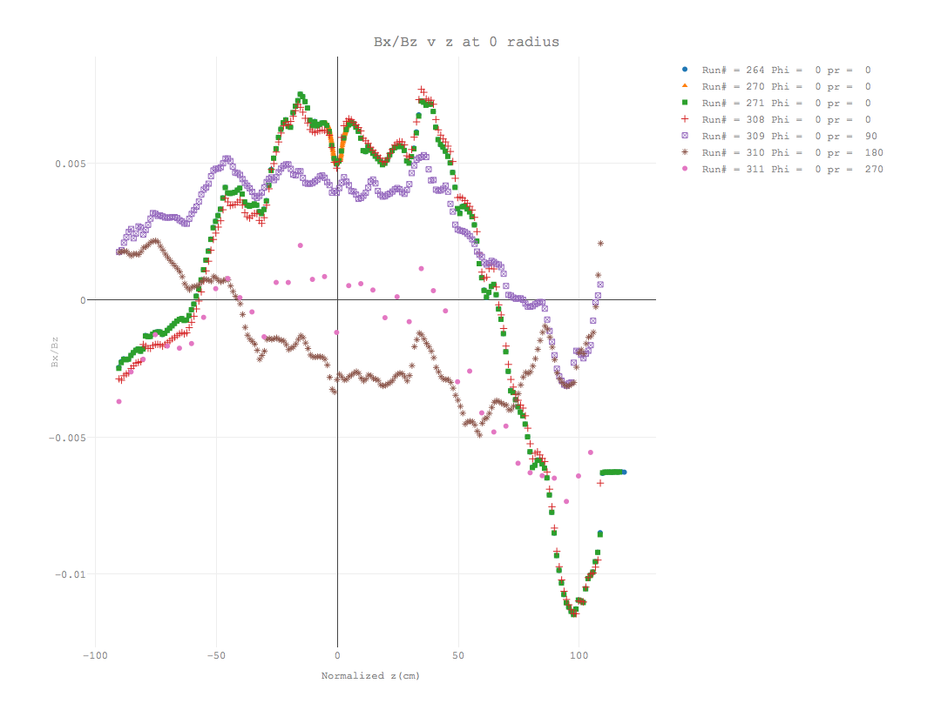
RESULTS

Slide 15
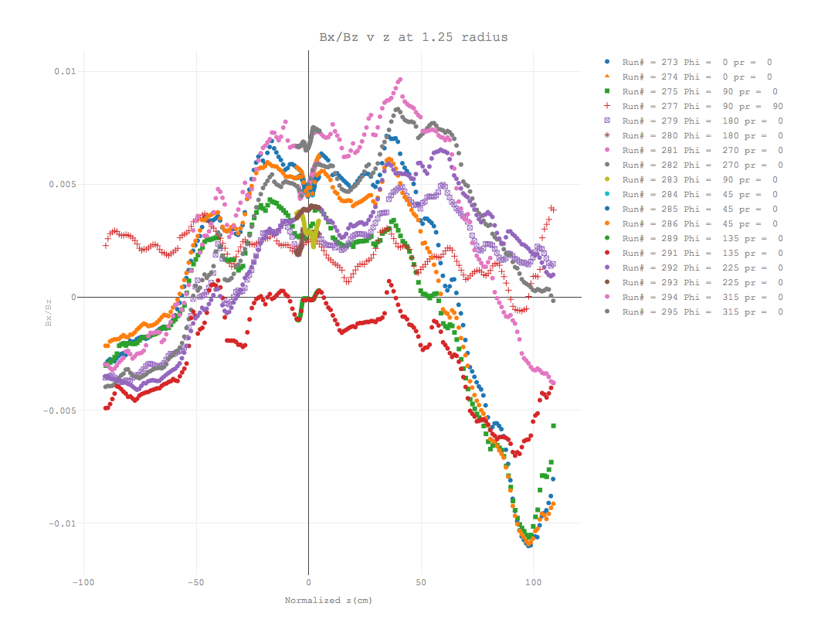
RESULTS

Slide 16
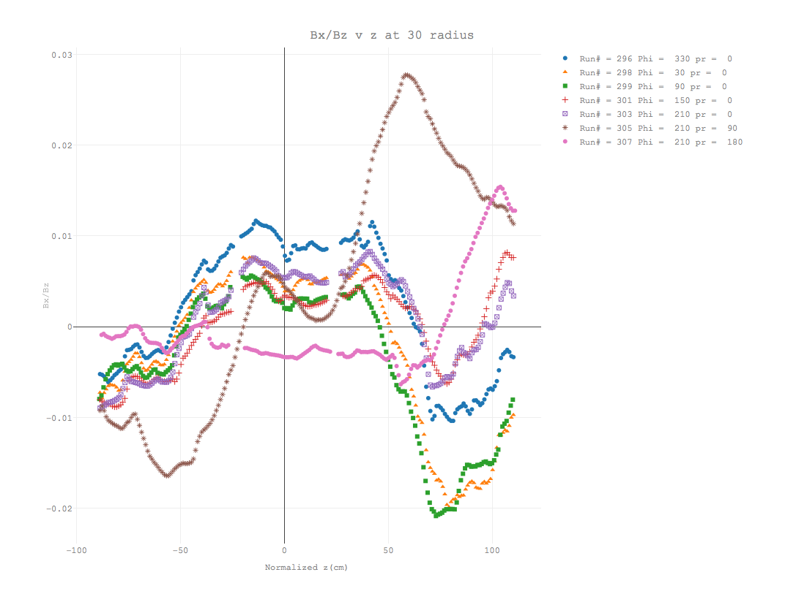
RESULTS

Slide 17
Conclusions and Outlook
Center z values vary by ±2.3cm between long runs
Center z values vary by ±0.50cm between short runs
There appears to be motion on the probe holders other than along the z axis
Isolate contribution of probe motion
Parameterization of the deviations from the model

